Slide 1



Advancing Rural Communication Service in Africa
24 NOVEMBER 2021
2:00PM (CET)

Slide 2
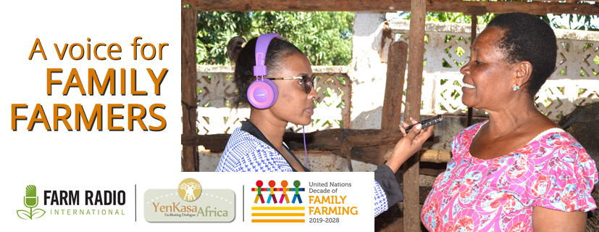
2020 campaign for UNDFF
Participatory design of campaign, selecting themes and key messages; development of radio spots and backgrounder packaged with radio scripts and news stories
Shared with Farm Radio’s network of more than 1,000 radio partners.
On air from late July to Oct 16, World Food Day.
110 stations participating fro 13 countries
Estimated 29 million potential audience (6 million potential rural listeners)

Slide 3
Being a Voice for Family Farmers
Radio broadcasters and other media actors are invited to participate in the campaign by:
broadcasting the campaign materials,
talking about the UNDFF,
interviewing farmers and farmer organizations,
putting farmer priorities at the core of their programming,
and promoting themselves as a “voice for family farmers.”
110 radio stations participated from 13 countries
Estimated potential listenership of 29 million (6 million rural) for just 21 of the stations

Slide 4
Feedback on Voice for Family Farmers campaign
Radio Paon in DRC indicated, « Les agriculteurs ont félicite cette initiative et ont suggère que ce partage de face a face mûrissent. En collaboration avec les associations des agriculteurs nous avons organisé des tables rondes. Pas moins de 500 agriculteurs ont interagi en appel et SMS et en boite de suggestions. » (Translation : Farmers commended this initiative and suggested that face-to-face sharing would enrich it. In collaboration with farmers' association, we organized round tables. No less than 500 farmers interacted by call-in, SMS, and suggestion box.)
Radio Baoulé in Mali said, « Les agriculteurs apprécient les messages et sont heureux d'être associe à un tel programme. Rarement, on les fait agir sur des sujets qui les concernent et les valorisent, selon eux. » (Translation : Farmers appreciate the messages and are happy to be associated with such a program. Rarely they are made to act on subjects which concern and value them, they say.)

